Slide 1



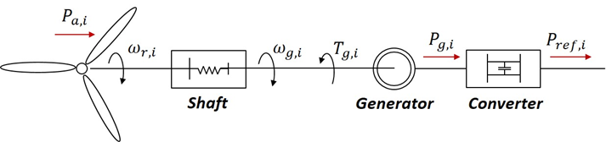
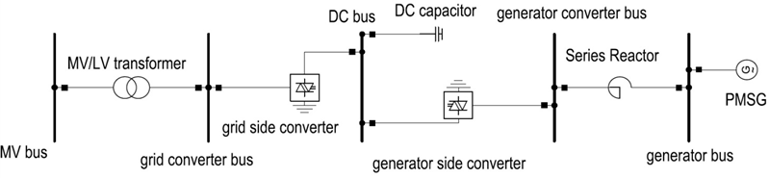
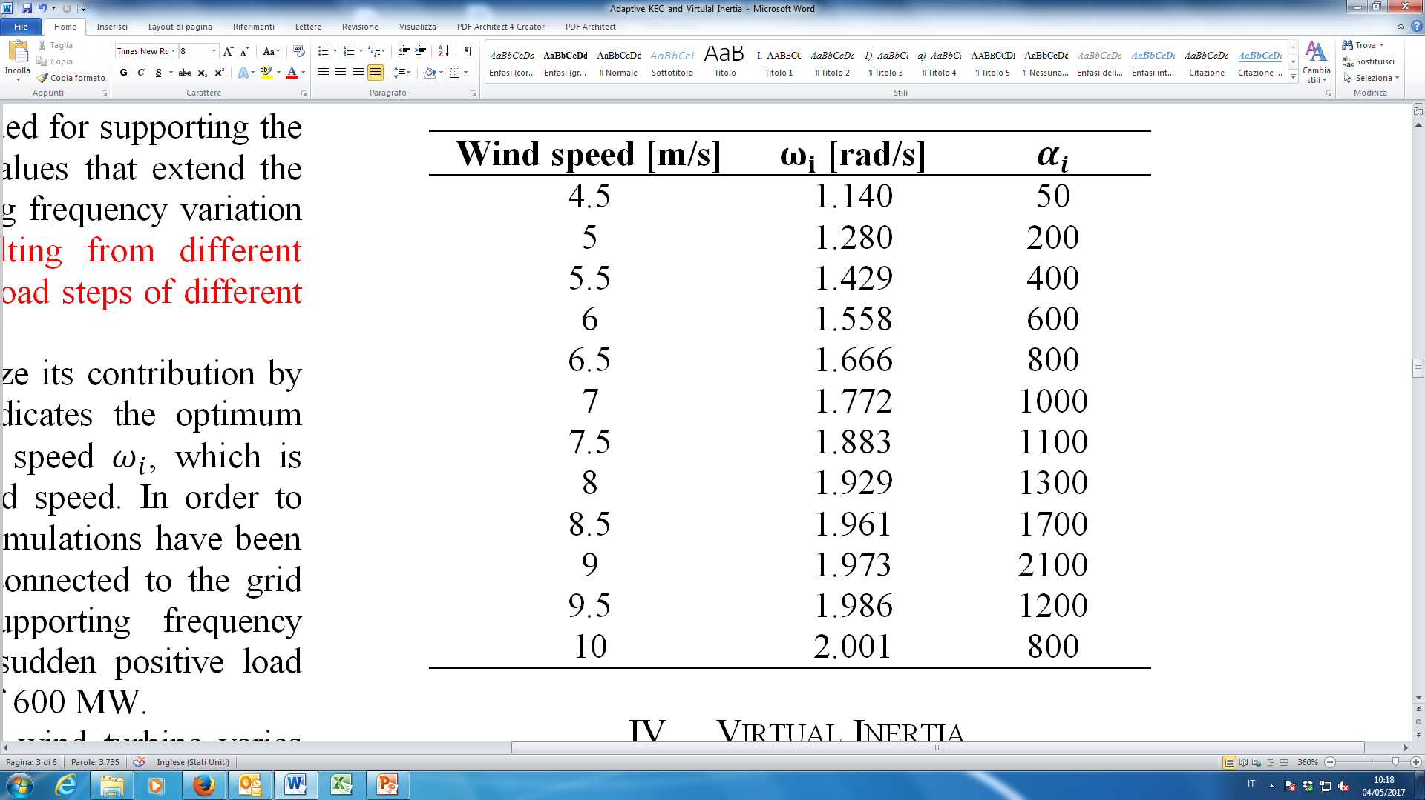
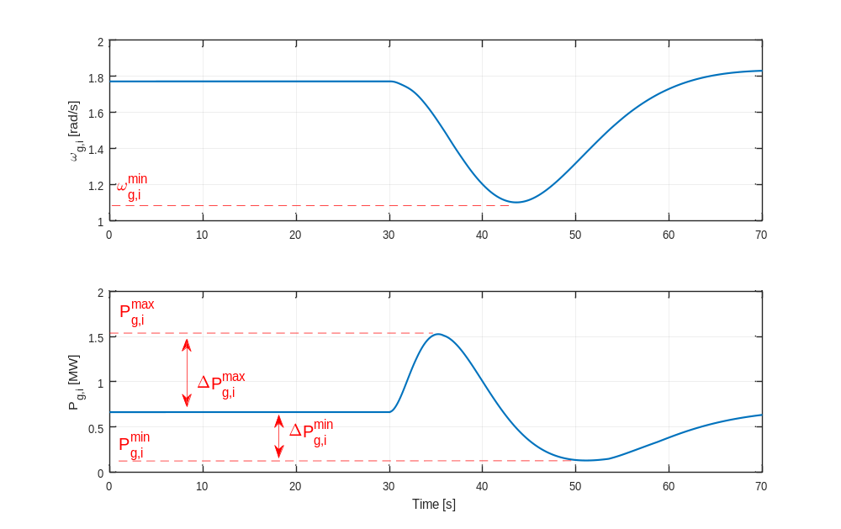
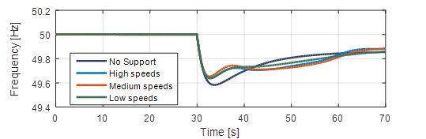
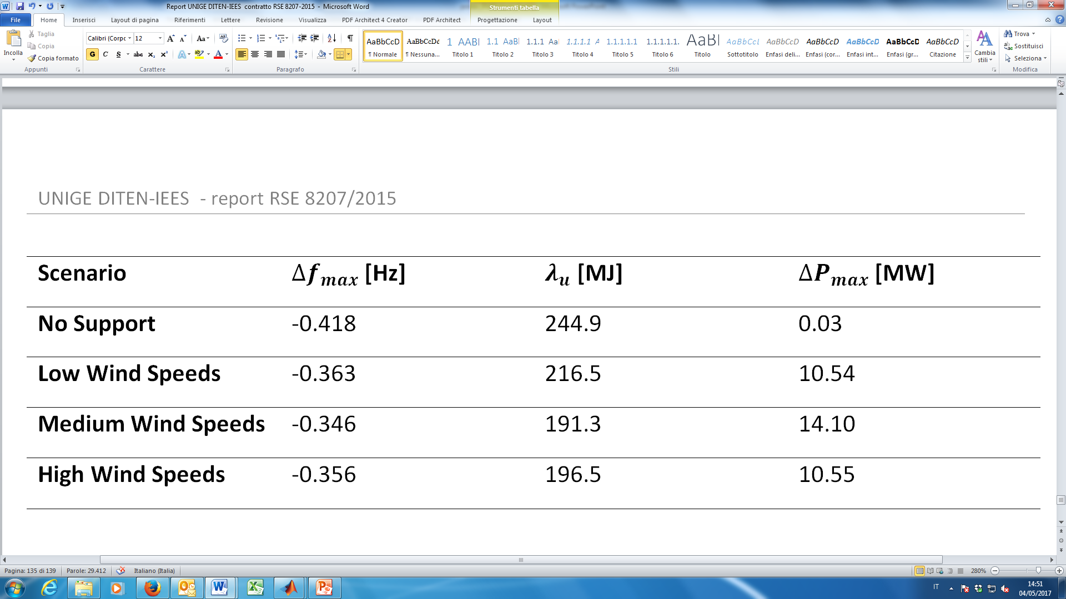

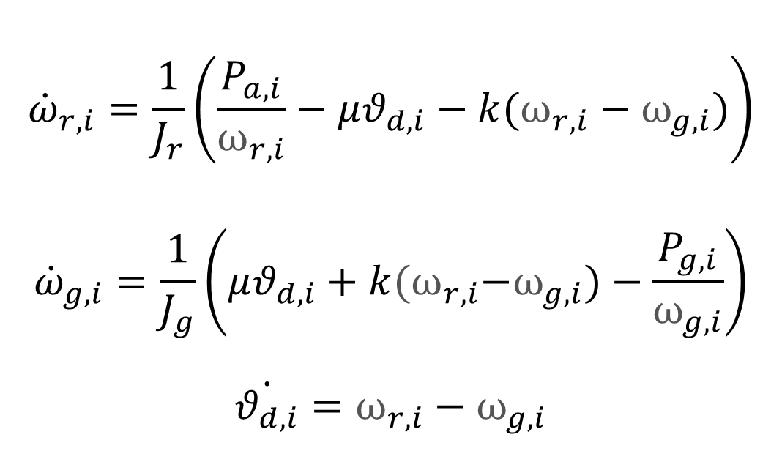
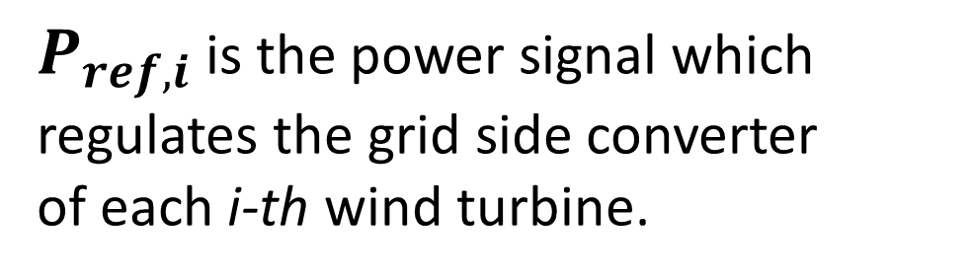
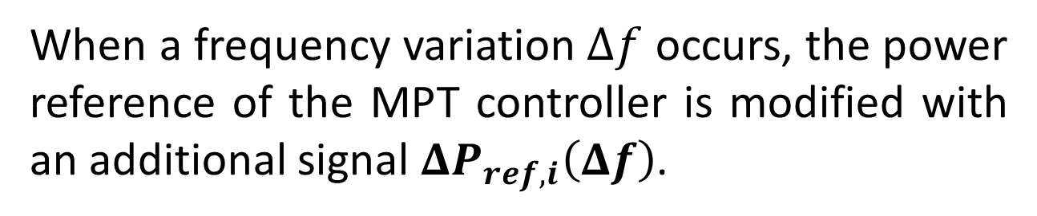
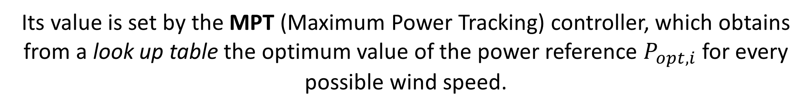

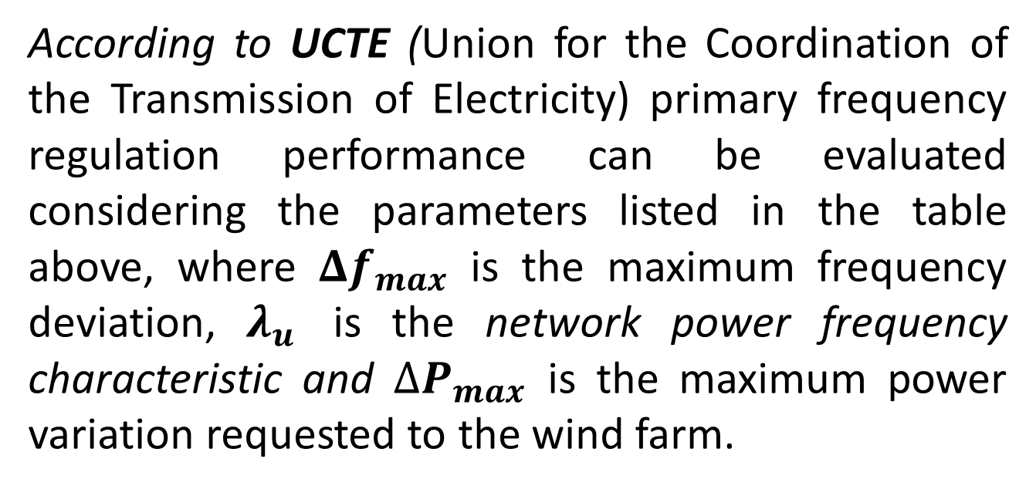
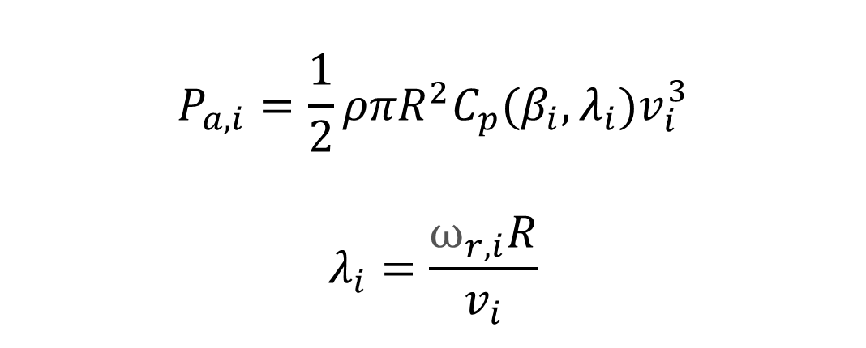
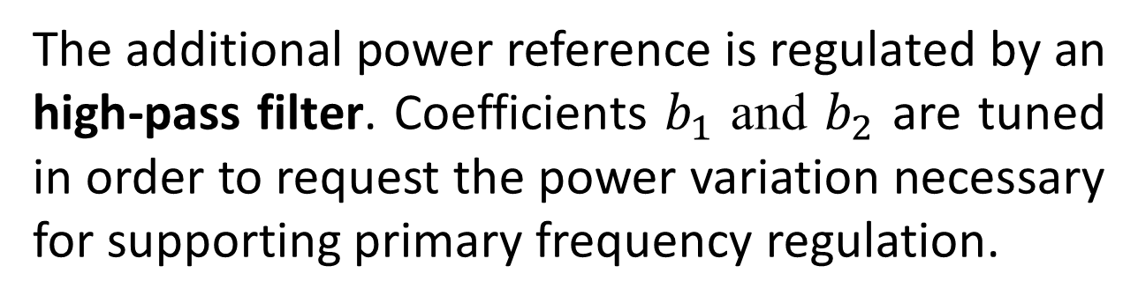
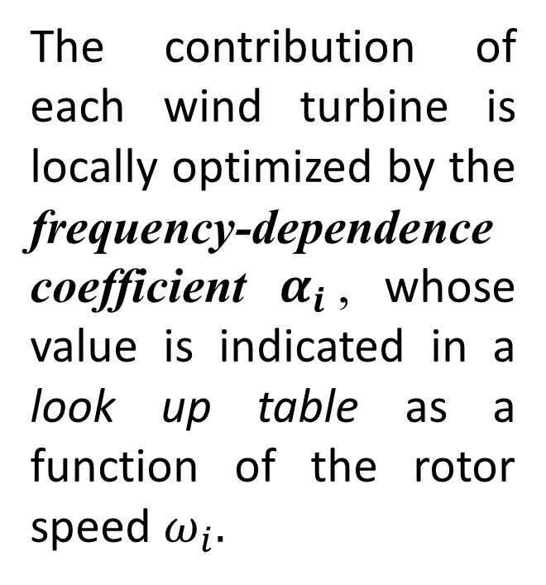
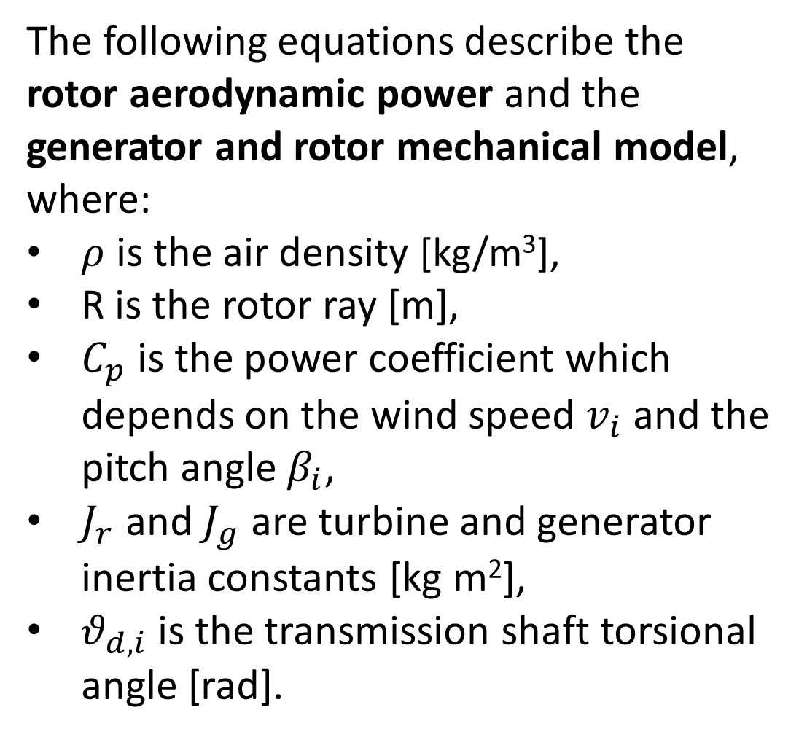
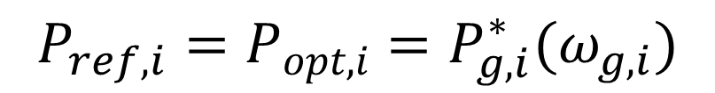
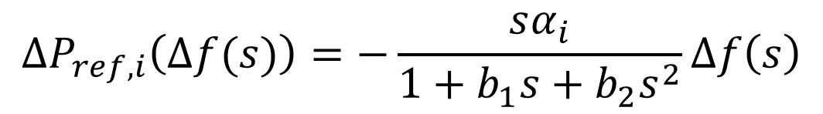
Wind Farm Contribution to Frequency Regulation by Distributed Adaptive Kinetic Energy Control
Monica Crosa di Vergagni
DITEN (Department of Electrical, Electronic, Telecommunication Engineering and Naval Architecture) - University of Genova – Italy
monica.crosadivergagni@edu.unige.it
Abstract
This work proposes a control technique to provide the contribution of wind power generators to primary frequency regulation in electric power systems. The kinetic energy kept by wind generators is used to temporarily modulate their power delivery for contributing to the grid frequency regulation. The control parameters are suitably tuned in order to maximize the contribution of each wind generator, as a function of the current wind speed. A look-up table is therefore built allowing the adaptation of the control action to the different dynamical states of the generators and obtaining, in this way, an optimal power response of the whole wind farm. An approach for allowing the wind farm to provide virtual inertia is also proposed. A detailed model of a large wind farm connected to the grid has been implemented in a dedicated simulation environment to test the effectiveness of the proposed control strategies.
Wind Farm Generator Model
Network Model and MPT Controller
The implemented wind farm is composed of twenty PMSG dynamic models. The turbines are located along four feeders. The main grid is represented by a load and a 1000 MW plant, with a steam turbine prime mover, frequency droop controller and automatic voltage regulator.
The following equations describe the rotor aerodynamic power and the generator and rotor mechanical model, where:
$ρ$ is the air density [kg/m³],
R is the rotor ray [m],
$C_{p}$ is the power coefficient which depends on the wind speed $v_{i}$ and the pitch angle $β_{i}$,
$J_{r}$ and $J_{g}$ are turbine and generator inertia constants [kg m²],
$θ_{d,i}$ is the transmission shaft torsional angle [rad].
$$P_{a,i}=\frac{1}{2}ρπR^{2}C_{p}(β_{i},λ_{i})v_{i}^{3}$$
$$λ_{i}=\frac{ω_{r,i}R}{v_{i}}$$
$${\dot{ω}}_{r,i}=\frac{1}{J_{r}}\left(\frac{P_{a,i}}{ω_{r,i}}−μθ_{d,i}−k(ω_{r,i}−ω_{g,i})\right)$$
$${\dot{ω}}_{g,i}=\frac{1}{J_{g}}\left(μθ_{d,i}+k{(ω}_{r,i}−ω_{g,i})−\frac{P_{g,i}}{ω_{g,i}}\right)$$
$$\dot{θ_{d,i}}=ω_{r,i}−ω_{g,i}$$
$P_{ref,i}$ is the power signal which regulates the grid side converter
of each i-th wind turbine.
$$P_{ref,i}=P_{opt,i}=P_{g,i}^{∗}(ω_{g,i})$$
Its value is set by the MPT (Maximum Power Tracking) controller, which obtains from a look up table the optimum value of the power reference $P_{opt,i}$ for every possible wind speed.
The Adaptive Kinetic Energy Control (KEC)
When a frequency variation $Δf$ occurs, the power reference of the MPT controller is modified with an additional signal $ΔP_{ref,i}\left(Δf\right)$.
$$P_{ref,i}=P_{opt,i}+ΔP_{ref,i}\left(Δf\right)$$
The contribution of each wind turbine is locally optimized by the frequency-dependence coefficient $α_{i}$, whose value is indicated in a look up table as a function of the rotor speed $ω_{i}.$
The additional power reference is regulated by an high-pass filter. Coefficients $b_{1}$ and $b_{2}$ are tuned in order to request the power variation necessary for supporting primary frequency regulation.
$$ΔP_{ref,i}\left(Δf(s)\right)=−\frac{sα_{i}}{1+b_{1}s+b_{2}s^{2}}Δf\left(s\right)$$
Results and Conclusions
Wind Turbine Speed and Power
Grid Frequency
Primary Frequency Regulation
Simulations have been conducted considering three different scenarios: low, medium and high wind speeds. At 30 s, a load variation occurs, leading to a sharp frequency deviation.
The wind farm is required to contribute to the grid control activities, leading to an improvement in the grid frequency evolution over time in all considered scenarios.
According to UCTE (Union for the Coordination of the Transmission of Electricity) primary frequency regulation performance can be evaluated considering the parameters listed in the table above, where $Δf_{max}$ is the maximum frequency deviation, $λ_{u}$ is the network power frequency characteristic and ${∆P}_{max}^{}$ is the maximum power variation requested to the wind farm.
When a frequency variation occurs, the wind turbine varies its generated power leading to a decrease of its rotor speed.
A paper based on this research project, written with other
co-authors, has been accepted for presentation at the IEEE PES General Meeting in Chicago, July 2017
DITEN
IEES - INTELLIGENT ELECTRIC
ENERGY SYSTEMS
LABORATORY
European PhD School
Gaeta , May 2017

